Slide 1
Advanced Socket Programming

Slide 2
Blocking I/O
In blocking I/O, operations like reading from or writing to a socket block the execution of the program until the operation completes.
This means that the program waits for the I/O operation to finish before proceeding to the next step.
For example, when a program calls recv() to read data from a socket, it will stop execution until data is available. Similarly, when it calls send(), it waits for the data to be sent before moving on.

Slide 3
How Blocking I/O Works
In blocking I/O, the socket function call will not return until the requested operation has been completed, meaning that the program will wait for:
  Data to arrive when reading from the socket.
  Confirmation of successful transmission when writing to the socket.
This can be inefficient in situations where multiple operations need to happen concurrently, especially when dealing with multiple client connections.

Slide 4
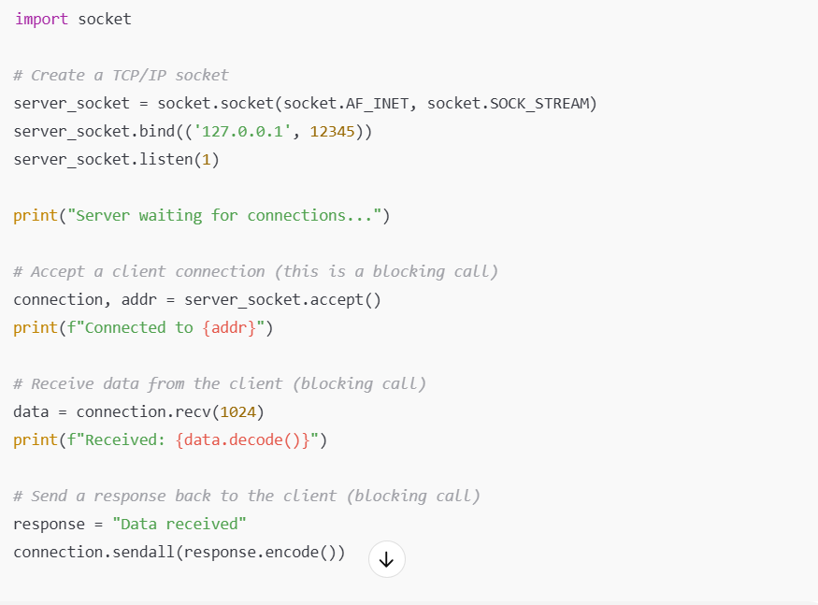
Example: Blocking I/O Socket Server

Slide 5
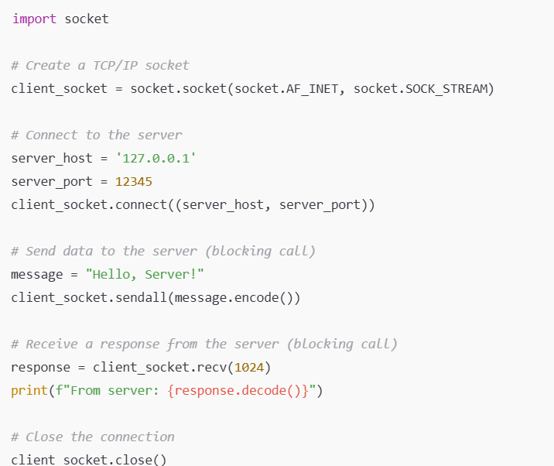
Example: Blocking I/O Socket Client

Slide 6
Characteristics of Blocking I/O
Simplicity: Blocking I/O is simple to implement, as you don't need to manage concurrency or deal with complex event loops. The code follows a linear flow.
Sequential Execution: Each I/O operation is performed one after another. The program waits for one operation (like reading from a socket) to finish before starting the next operation (like writing to a socket)

Slide 7
Characteristics of Blocking I/O
No Need for Polling: Since the program halts at each blocking operation, there’s no need to continuously check (poll) the socket to see if it’s ready for reading or writing.
Inefficiency in Concurrency: When handling multiple clients or doing I/O-bound tasks, blocking I/O can lead to inefficiencies because the program spends a lot of time waiting for I/O operations to complete.

Slide 8
Advantages of Blocking I/O
Simplicity: Blocking I/O is often easier to write and reason about. The program flow is sequential, so it’s easier to understand than more complex non-blocking or asynchronous models.
Fewer Threads/Processes: For small, simple applications, blocking I/O does not require managing multiple threads or processes. It can be the simplest choice for applications that are not expected to handle many concurrent connections.
Easier Debugging: Since the program execution is linear, it’s easier to debug issues compared to more complex, concurrent programming models.

Slide 9
Disadvantages of Blocking I/O
Inefficiency in Handling Multiple Connections: When handling multiple clients (e.g., in a web server), blocking I/O can be inefficient because the server must wait for each client's I/O operation to complete before moving on to the next client. This results in idle time and limited scalability.
Poor Responsiveness: The program can become unresponsive if it's waiting on I/O operations. For example, while waiting for data to be received from a client, the server cannot perform other tasks like accepting new connections.

Slide 10
Disadvantages of Blocking I/O
Scalability Problems: A blocking I/O server would need one thread per client or would use multiplexing techniques (like select) to handle multiple clients. But this still involves waiting (blocking) and is not as efficient as an asynchronous or non-blocking approach.

Slide 11
When to Use Blocking I/O
Blocking I/O can be a suitable approach in situations like:
  Simple Applications: Where you don't need to handle many clients concurrently or the application is not I/O-bound (e.g., command-line tools, simple client-server programs).
  Real-Time Applications: For certain real-time applications where responses are required quickly and there’s no need to wait for multiple concurrent I/O operations.
  Single-Threaded Systems: Where you can afford the overhead of waiting for each operation to finish, or the number of concurrent operations is small enough to not cause performance issues.

Slide 12
How to Handle Multiple Clients with Blocking I/O
With blocking I/O, handling multiple clients often requires using multiple threads or processes so that each client can have its own independent execution flow.

Slide 13
Nonblocking I/O
In non-blocking I/O, operations like reading from or writing to a socket do not wait for the operation to complete.
Instead, the program can continue executing other tasks while waiting for the I/O operation to complete.
This contrasts with blocking I/O, where a program stops and waits until the operation finishes.
Non-blocking I/O is a critical concept for building scalable network applications, especially when managing many simultaneous client connections.

Slide 14

How Non-Blocking I/O Works
Traditional Blocking I/O: In blocking mode (default for sockets), functions like recv() or send() halt the program until data is available or the operation is complete.
This approach can lead to inefficiencies, especially when handling multiple connections, as the program might spend time idly waiting for data.

Slide 15
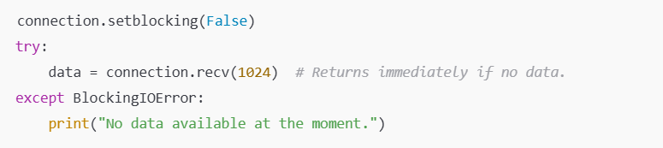
How Non-Blocking I/O Works
In non-blocking mode, I/O operations return immediately if no data is available or if the operation cannot proceed.
The program can check back later or use mechanisms like polling or event loops to handle data when it becomes available.

Slide 16
Benefits of Non-Blocking I/O
Efficiency: The program isn't stuck waiting for I/O operations to complete and can perform other tasks in the meantime.
Scalability: Handles many connections with fewer system resources compared to threading or multiprocessing.
Responsiveness: Suitable for interactive applications where immediate feedback is essential.

Slide 17
Key Concepts in Non-Blocking I/O
Polling:
  The program repeatedly checks the status of a socket to see if it is ready for reading or writing.
  Inefficient for high-performance applications because it wastes CPU cycles.
Event Loops:
  A more efficient alternative, where the program registers sockets with an event loop.
  The loop notifies the program when a socket is ready for I/O operations.
  Libraries like select, poll, epoll, and asyncio provide mechanisms for event-driven programming.

Slide 18
Key Concepts in Non-Blocking I/O
Callbacks
  Some frameworks use callbacks to handle I/O events, executing specific functions when data is available.

Slide 19
Example: Non-Blocking Socket in Python

Slide 20
Advanced socket concepts
Advanced socket concepts go beyond a general discussion of what sockets are and how they work.
These concepts provide ways to design socket applications for larger and more complex networks.
We will learn concurrent and parallelism techniques

Slide 21
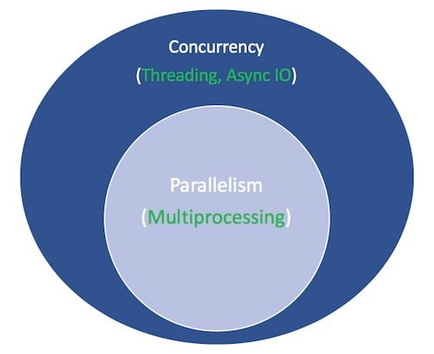

Slide 22
Parallelism
Parallelism consists of performing multiple operations at the same time.
Multiprocessing is a means to effect parallelism, and it entails spreading tasks over a computer’s central processing units (CPUs, or cores).
Multiprocessing is well-suited for CPU-bound tasks: tightly bound for loops and mathematical computations usually fall into this category.

Slide 23
Multiprocessing
Multiprocessing uses multiple processes, each with its own memory space, to execute tasks in parallel.
Each client is handled in a separate process, providing better isolation compared to threads.
Python's Global Interpreter Lock (GIL) affects threads but not processes, making multiprocessing better suited for CPU-bound tasks.
Multiprocessing uses more memory and system resources compared to threading.

Slide 24
Key Features
Bypasses the GIL: Python's Global Interpreter Lock (GIL) does not apply to multiprocessing because each process runs independently in its own memory space.
Better for CPU-bound tasks: Ideal for tasks that require heavy computation, such as numerical calculations or data processing.
Inter-process Communication (IPC): Requires mechanisms like Queue, Pipe, or Manager for processes to share data.

Slide 25
Advantages
Exploits multiple CPU cores effectively.
Independent processes mean one process crashing won't affect others.
Avoids Python's GIL, enabling true parallelism.

Slide 26
Disadvantages
Higher memory overhead due to separate memory spaces for each process.
Slower communication between processes (compared to threads) because of the need for IPC mechanisms.
Creating and managing processes is generally slower than threads.

Slide 27
Example: Multiprocessing Server
Manager for Shared State: The Manager is used to create a shared list (client_sockets) that allows processes to share state safely.
Separate Processes for Clients: Each client connection is handled by a separate process created using the Process class.
Broadcasting Messages: The broadcast function iterates over the shared client_sockets list to send a message to all clients.
Graceful Client Removal: If a client disconnects or an error occurs, the client socket is removed from the shared list, and the process handling that client terminates.

Slide 28
Multiprocessing Client
Multiprocessing for Receiving Messages: The receive_messages function runs in a separate process, created using multiprocessing.Process.
Main Process for Sending Messages: The main process handles user input and sends messages to the server.
Graceful Shutdown: A KeyboardInterrupt (Ctrl+C) is captured to close the socket and terminate the receiving process cleanly.

Slide 29
Concurrency
Concurrency is a slightly broader term than parallelism. It suggests that multiple tasks have the ability to run in an overlapping manner.
Asynchronous I/O is a style of concurrent programming.
Multithreading in Python is concurrent, not parallel, for most tasks. Threads take turns executing, giving the illusion of simultaneity.

Slide 30
Threads
Threads are similar to processes in that they allow for parallelization of work. However, each thread is owned by a single process.
Unlike processes, threads can share the same memory space and can access each other’s data.
Threads are owned and created by a single process, and are only alive as long as the parent process is alive.
As soon as a process starts, all work is done in the main thread created by default, but you can add new threads at runtime.

Slide 31
Socket Programming with Multi-threading
Multiple clients can connect and interact with the server simultaneously.
The server doesn't block waiting for one client's interaction to complete.

Slide 32
Threads and Sockets in Python
A process is an executing program with a dedicated memory space.
Many processes run at the same time on a computer.
When you execute a script (like python3 tcp_server.py), your code runs in a new process.
The biggest thing to note is that processes have isolated memory spaces, so one process cannot access the data of another process.

Slide 33
Multithreading
Multithreading uses multiple threads within the same process to execute tasks concurrently.

Slide 34
Python threading library
The Python threading library facilitates running functions in separate threads.
The main() function runs concurrently with the worker() function after thread.start(). When the Main thread runs thread.join(), it will wait until the second thread finishes before running any more code.

Slide 35
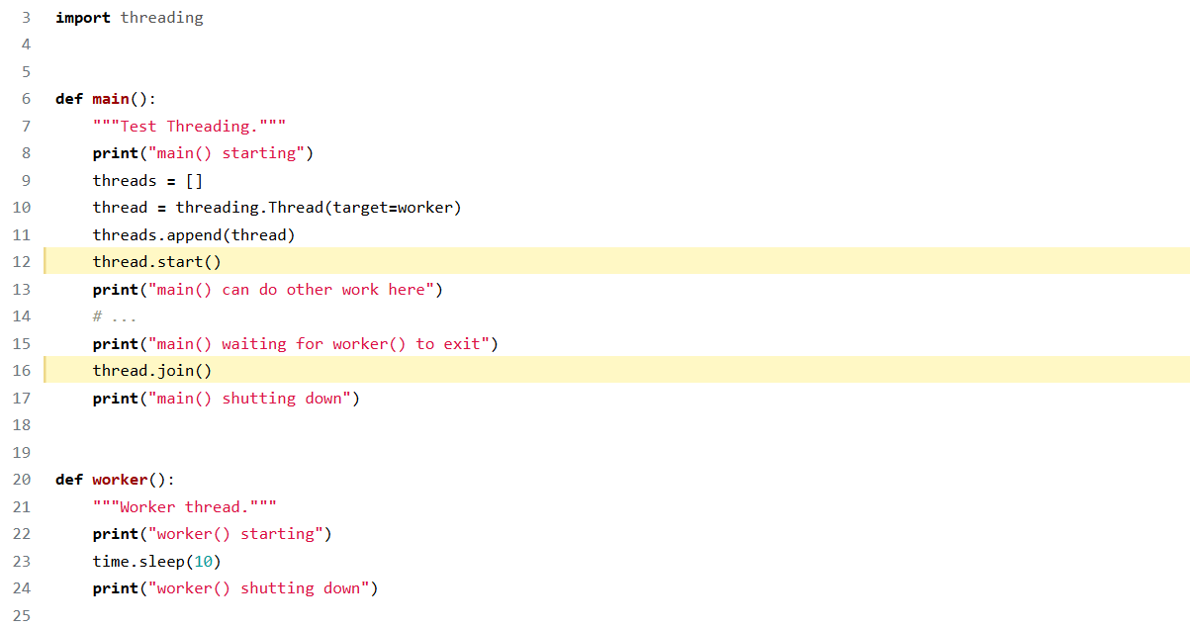

Slide 36
Key Features
GIL Constraint: In Python (especially CPython), the GIL ensures that only one thread runs Python bytecode at a time, even on multicore systems.
Better for I/O-bound tasks: Useful for tasks like file operations, network communication, or database queries, where the program spends time waiting for external resources.
Shared Memory: Threads share the same memory space, making communication simpler.

Slide 37
Advantages
Lightweight compared to processes, leading to lower memory overhead.
Faster thread creation and context switching.
Easier to share data between threads since they share the same memory space.

Slide 38
Disadvantages
Affected by the GIL in Python, limiting parallel execution for CPU-bound tasks.
Shared memory requires careful synchronization (e.g., using locks) to avoid race conditions and data corruption.
A crash in one thread can affect the entire process.

Slide 39
Asynchronous
Asynchronous routines are able to “pause” while waiting on their ultimate result and let other routines run in the meantime.
Asynchronous code, through the mechanism above, facilitates concurrent execution. To put it differently, asynchronous code gives the look and feel of concurrency.

Slide 40
Asynchronous I/O
Asynchronous I/O APIs provide a method for threaded client/server models to perform highly concurrent and memory-efficient I/O.
async IO is a single-threaded, single-process design:
  it uses cooperative multitasking
  async IO gives a feeling of concurrency despite using a single thread in a single process.
  Coroutines (a central feature of async IO) can be scheduled concurrently, but they are not inherently concurrent.

Slide 41
Async IO Explained
Chess master Judit Polgár hosts a chess exhibition in which she plays multiple amateur players. She has two ways of conducting the exhibition: synchronously and asynchronously.
Assumptions:
  24 opponents
  Judit makes each chess move in 5 seconds
  Opponents each take 55 seconds to make a move
  Games average 30 pair-moves (60 moves total)

Slide 42
Synchronous version
Judit plays one game at a time, never two at the same time, until the game is complete. Each game takes (55 + 5) * 30 == 1800 seconds, or 30 minutes. The entire exhibition takes 24 * 30 == 720 minutes, or 12 hours.

Slide 43
Asynchronous version
Judit moves from table to table, making one move at each table. She leaves the table and lets the opponent make their next move during the wait time. One move on all 24 games takes Judit 24 * 5 == 120 seconds, or 2 minutes. The entire exhibition is now cut down to 120 * 30 == 3600 seconds, or just 1 hour.

Slide 44
Recap
Concurrency encompasses both multiprocessing (ideal for CPU-bound tasks) and threading (suited for IO-bound tasks).
Multiprocessing is a form of parallelism, with parallelism being a specific type (subset) of concurrency.

Slide 45
Asynchronous I/O is a style of concurrent programming
async IO is a style of concurrent programming, but it is not parallelism.

Slide 46
Asynchronous programming
Asynchronous programming is a programming paradigm that enables tasks to run independently of the main program flow, allowing the program to perform other operations while waiting for a task to complete.
It’s particularly useful for I/O-bound or event-driven tasks where operations like reading from a file, making network requests, or querying a database may take an unpredictable amount of time.

Slide 47
Key Concepts in Asynchronous Programming
Concurrency: Asynchronous programming allows multiple tasks to progress at the same time without blocking each other.
Non-Blocking I/O: Instead of waiting for an I/O operation (like reading a file or fetching data from a server) to complete, the program continues executing other tasks.
Event Loop: Central to asynchronous programming, the event loop is responsible for managing and scheduling tasks. It continuously checks for completed operations and executes associated callbacks or resumes suspended coroutines.

Slide 48
Key Concepts in Asynchronous Programming
Callbacks: Functions or routines executed when an asynchronous operation completes. They are used to handle the result of the operation.
Promises/Futures: Represent a placeholder for a value that will be available at some point in the future. They are commonly used in asynchronous APIs.
Coroutines: Specialized functions that can pause execution (await) and resume later. They form the backbone of asynchronous programming in many modern languages like Python, JavaScript, and Kotlin.

Slide 49
Example: Asynchronous Programming in Python with asyncio
Sequential (Synchronous) Code: Each task waits for the previous one to finish
Asynchronous Code: All tasks start concurrently and finish

Slide 50
Non-Blocking I/O with Asyncio
The asyncio library uses non-blocking I/O under the hood. It avoids the need for manual polling or error handling like BlockingIOError.
asyncio is a Python library that provides support for asynchronous programming. It simplifies handling multiple I/O operations, such as working with sockets, without blocking the program's execution. This is particularly useful in socket programming when you want to manage multiple client connections efficiently.

Slide 51
Key Features of asyncio in Socket Programming
Event Loop:
  The core of asyncio is its event loop, which manages tasks, I/O events, and coroutines.
  It enables you to perform multiple socket operations concurrently without using threads or processes.
Coroutines:
  Functions defined with async def that allow you to pause execution using await
  This pause lets the event loop perform other tasks while waiting for I/O operations to complete.

Slide 52
Key Features of asyncio in Socket Programming
Streams API:
  asyncio provides StreamReader and StreamWriter for working with sockets. These abstractions simplify reading from and writing to sockets.
Concurrency:
  asyncio handles multiple clients concurrently by running their tasks in a single-threaded event loop, avoiding the overhead of threads or processes.

Slide 53
How asyncio Works in Socket Programming
asyncio simplifies managing non-blocking I/O by allowing you to work with await and async syntax to schedule socket operations without blocking the main thread.
Server: Use asyncio.start_server() to create a server that listens for connections and spawns a coroutine (handle_client) for each client.
Use asyncio.open_connection() to establish a connection to the server and communicate using the StreamReader and StreamWriter objects.

Slide 54
Challenges of Asynchronous Programming
Complexity: Code can become harder to understand and debug, especially with nested callbacks or dependencies.
Debugging: Asynchronous stack traces can be harder to follow compared to synchronous code.
Error Handling: Requires careful handling of exceptions across asynchronous boundaries.
Compatibility: Not all libraries or frameworks are designed to work in an asynchronous context.

Slide 55
Event Loops
An event loop is a programming construct that continuously monitors events and dispatches them to event handlers.
In the context of asynchronous programming, an event loop manages the execution of asynchronous tasks and ensures that they are executed concurrently

Slide 56
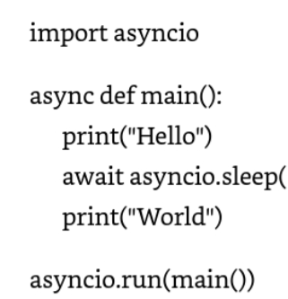
Example
In this example, the asyncio.run() function creates and runs an event loop, executing the main() coroutine.
The event loop manages the execution of asynchronous tasks, such as asyncio.sleep(), and ensures that they are executed in the correct order.
Event loops are particularly useful in I/O-bound applications, where tasks spend a significant amount of time waiting for I/O operations to complete.
By using event loops, programs can handle multiple concurrent tasks efficiently and improve the overall performance.

Slide 57
Tasks
A task is a high-level abstraction in asyncio that represents an individual unit of work or an asynchronous operation. Tasks are created from coroutines and can be scheduled to run on the event loop concurrently.

Slide 58
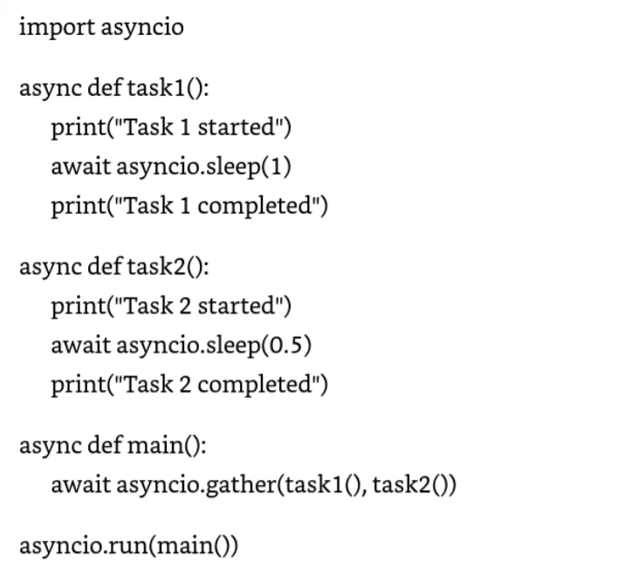
Example
In this example, we define two coroutines (task1 and task2) that represents asynchronous tasks.
We then use the asyncio.gather() function to run these tasks concurrently on the event loop. This allows both tasks to execute asynchronously and their ouputs to be interleaved.

Slide 59
Async/Await keywords
Async/Await keywords are used in Python to define coroutines and manage asynchronous operations and enable non-blocking execution of code
  Async: The async keyword is used to define a coroutine function. It marks the function as asynchronous, allowing to use the await keyword and be scheduled for the execution on the event loop
  Await: The await keyword is used to pause the execution of a coroutine until an asynchronous operation completes. It allows the coroutine to wait for the result of the operation without blocking the event loop.
Async/Await syntax allows for chaining asynchronous calls, making it easy to compose complex asynchronous operations

Slide 60
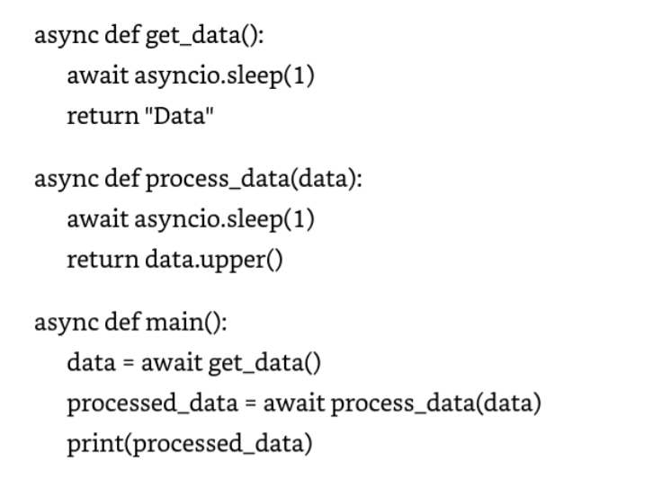
Example
In this example, the main coroutine calls get_data() to retrieve data asynchronously, then calls process_data() to process the data asynchronously.
The await keyword is used to wait for each operation to complete before proceeding to the next.

Slide 61
Writing Asynchronous Functions with async/await
Defining Asynchronous Functions
Using Asynchronous Functions
Error Handling in Asynchronous functions

Slide 62
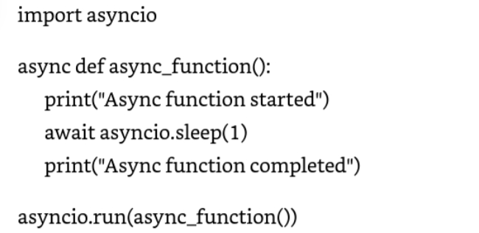
Defining Asynchronous Functions
In Python, asynchronous functions are defined using the async keyword, which marks the function as a coroutine. Coroutines can be suspended and resumed, allowing for non-blocking execution of code
In this example, async_function is defined as an asynchronous function using the asyn keyword. Inside the function, the await keyword is used to pause execution for one second using asyncio.sleep() before completing the function

Slide 63
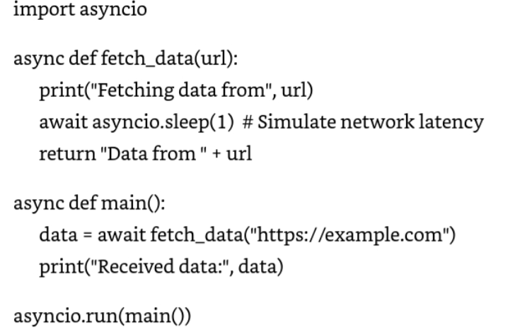
Using asynchronous functions
Asynchronous functions can be used in various scenarios where non-blocking execution is desired, such as I/O-bound operations or network requests.
In this example, the fetch_data function fetches data from a URL asynchronously using asyncio.sleep() to simulate network latency. The main coroutine calls fetch_data and awaits the result before printing the received data

Slide 64
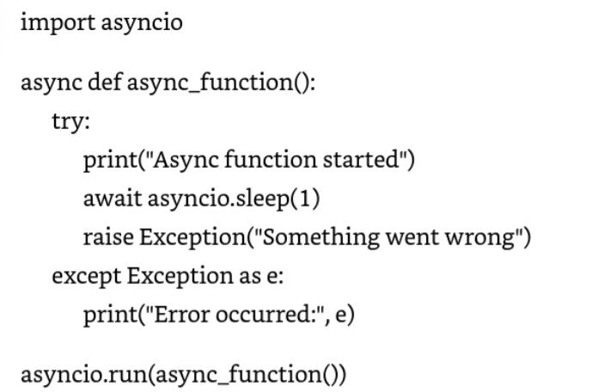
Error Handling in Asynchronous Functions
Error handling in asynchronous functions is straightforward and can be done using try and except blocks as in synchronous code.

